Slide 1
Chapter 12
Machine learning system design
Prioritizing what to work on: Spam classification example

Slide 2

Chapter 12

Slide 3
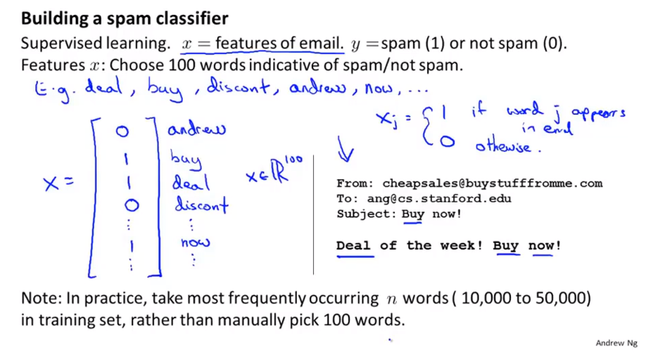
Chapter 12

Slide 4
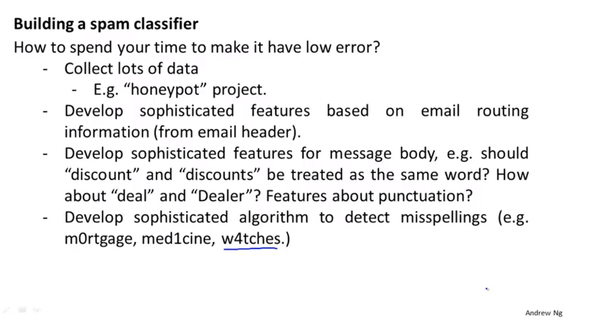
Chapter 12

Slide 5
Chapter 12
Machine learning system design
Error analysis
Which will help to give you a way to more systematically make some of these decisions.

Slide 6
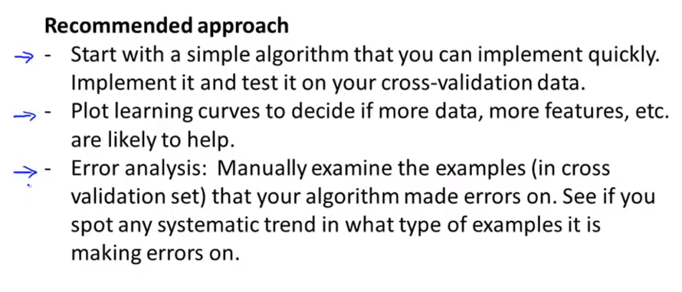
Chapter 12
This is the process that will inspire you to design new features, or they’ll tell you whether the current things or current shortcomings of the system and give you the inspiration you need to come up with improvements to it.
Avoiding sometimes called premature optimization in computer programming. And this is idea that just says that we should let evidence guide our decision on where to spend our time rather than use gut feeling which is often wrong,

Slide 7
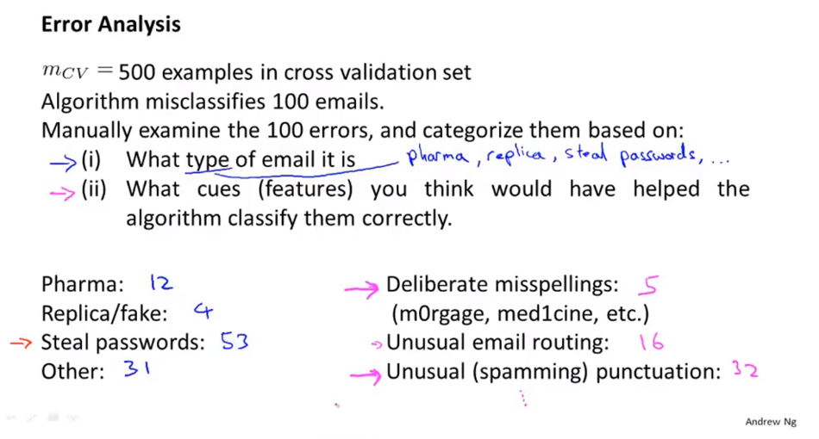
Chapter 12

Slide 8
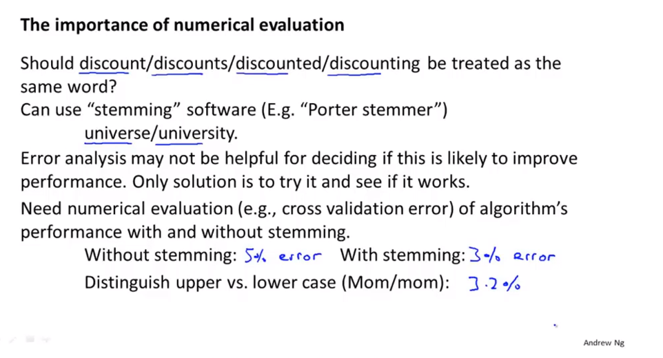
Chapter 12

Slide 9
Chapter 12
To warp up.
When starting on the new machine learning problem what I almost recommend is to implement a quick and dirty implementation of your learning algorithm.
First we can look at the errors it makes and do this sort of error analysis to see what mistakes it makes and use that to inspire further development.
Second, assuming your quick and dirty implementation incorporated a single rule number evaluation metric. This can be a vehicle for you to try out different ideas and quickly see if the different ideas you’re trying out are improving the performance of your algorithm and therefore let you maybe much more quickly make decisions about what things to fold and what things to incorporate into your learning algorithm.
Having error metrics that is of having a single real number evaluation metric for your learning algorithm to tell how well it’s doing.

Slide 10
Chapter 12
Machine learning system design
Error metrics for skewed classes
It’s particularly tricky to come up with an appropriate error metric, or evaluation metric, for you learning algorithm. That case is the case of what’s called skewed classes.

Slide 11
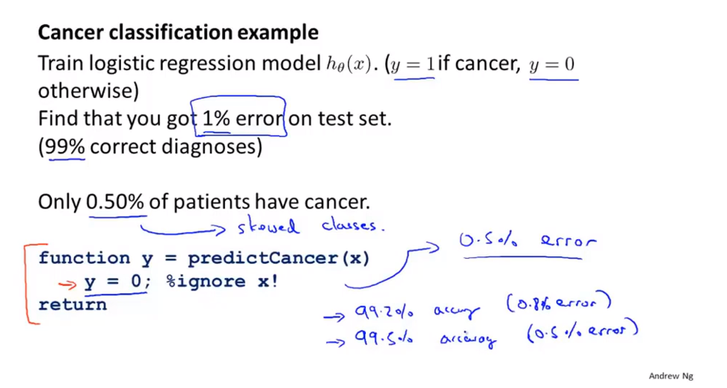
Chapter 12

Slide 12
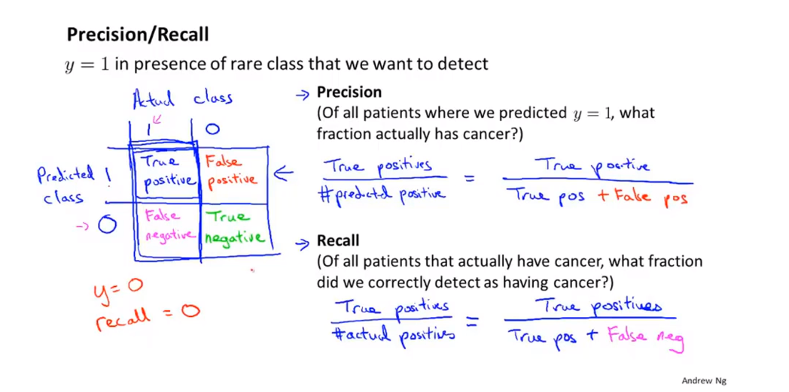
Chapter 12
By using precision and recall, we find, what happens is that even if we have very skewed classes, it’s not impossible for an algorithm to “cheat” and predict y equal 1 all the time, or predict y equals 0 all the time and get high precision and recall. And particular, if a classifier is getting high precision and high recall then we are actually confident that the algorithm has to be doing well even we have very skewed classed.
This is often a much better way to evaluate our learning algorithms than looking at classification error or classification accuracy when our class is skewed.

Slide 13
Chapter 12
Machine learning system design
Trading off position and recall

Slide 14
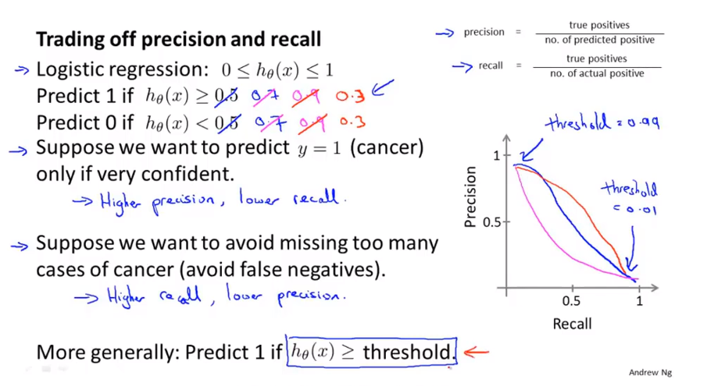
Chapter 12
Threshold 临界值
70 percent confident 置信度

Slide 15
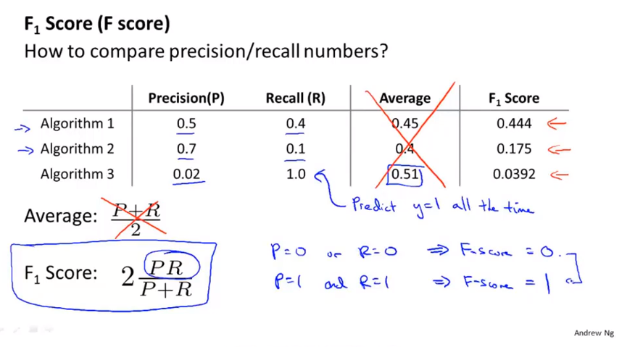
Chapter 12
It determines use is a little bit like taking the average of precision of recall, but it gives the lower value of precision and recall whichever it is – it gives it a higher weight.
Either precision is 0 or recall is 0, this gives you a very low f score. So to have a high f score you kind of need a preserve recall to be 1. Between 0 and 1, it will give you a reasonable rank ordering of different classifiers.

Slide 16
Chapter 12
Machine learning system design
Data for machine learning
It turns out that under certain conditions, getting a lot of data and training on a certain type of learning algorithm can be a very effective way to get a learning algorithm to do very good performance .
And this arises often enough that if those conditions hold true for your problem and if you’re able to get a lot of data, this could be a very good way to get a very high performance learning algorithm.

Slide 17
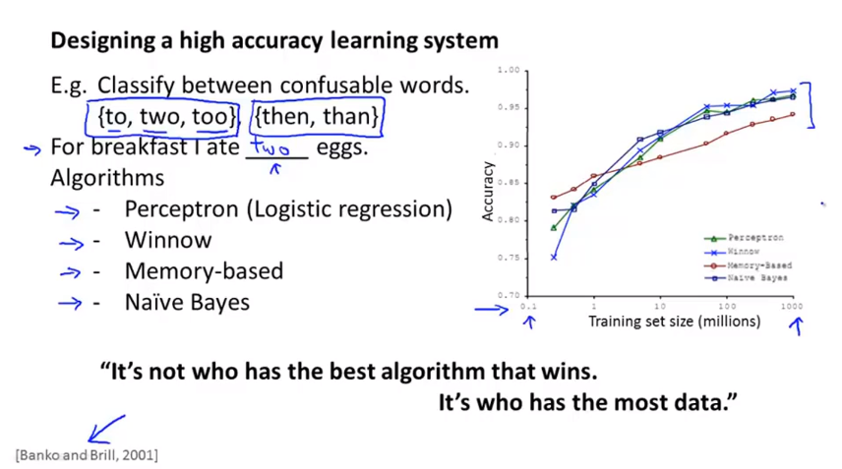
Chapter 12

Slide 18
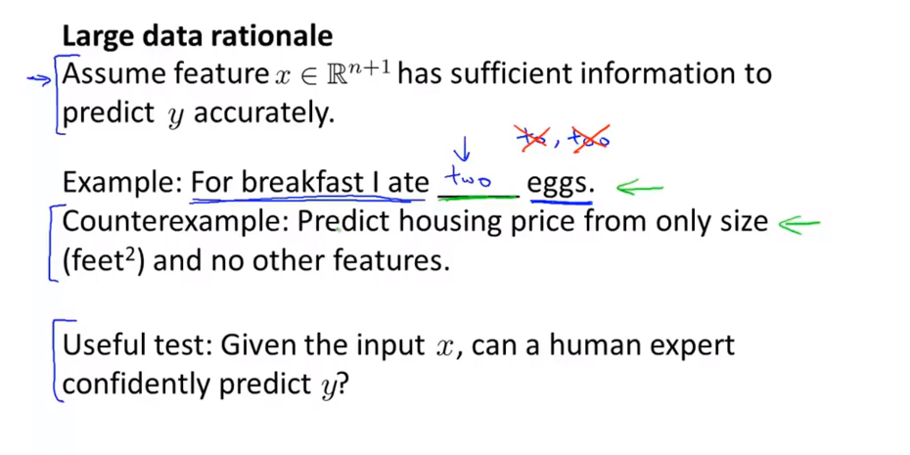
Chapter 12

Slide 19
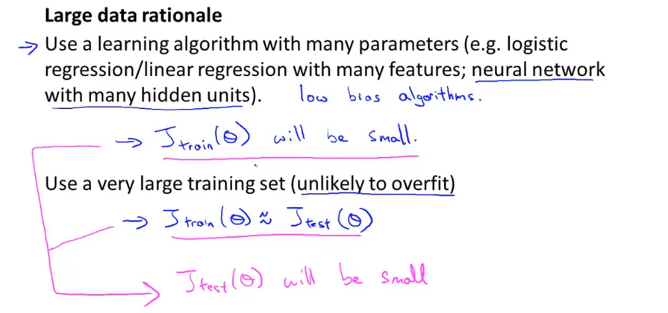
Chapter 12
The bias problem, we are going to address by making sure we have a learning algorithm with many parameters and so that gives us a low bias algorithm and by using a very large training set,
this ensures we don’t have high variance.
And fundamentally it’s a key ingredients of assuming that the features have enough information and we have a rich class of functions. That’s why it guarantees low bias. And then it having a massive training set, that’s what guarantees more variance. (low?)

Slide 20
Chapter 12
Summary:
So this gives us a set of conditions rather hopefully some understanding of what’s the sort of problem where if you have a lot of data and you train a learning algorithm with a lot of parameters that might be a good way to give a high performance learning algorithm.
The key test, first, can human experts look at the features x and confidently predict the value of y. Because that’s sort of certification that y can be predicated accurately from the features x and second, can we actually get a large training set, and train the learning algorithm with a lot of parameters in the training set, and if you can do both, that’s often give you a very high performance learning algorithm.

